Slide 1
heaps
Twee soorten
  MinHeap : voor elke subtree geldt: kleinste is parent => root = minimum
  MaxHeap: voor elke subtree geldt: grootste is parent => root = maximum
Bijzondere binaire bomen
  Altijd in evenwicht

Slide 2
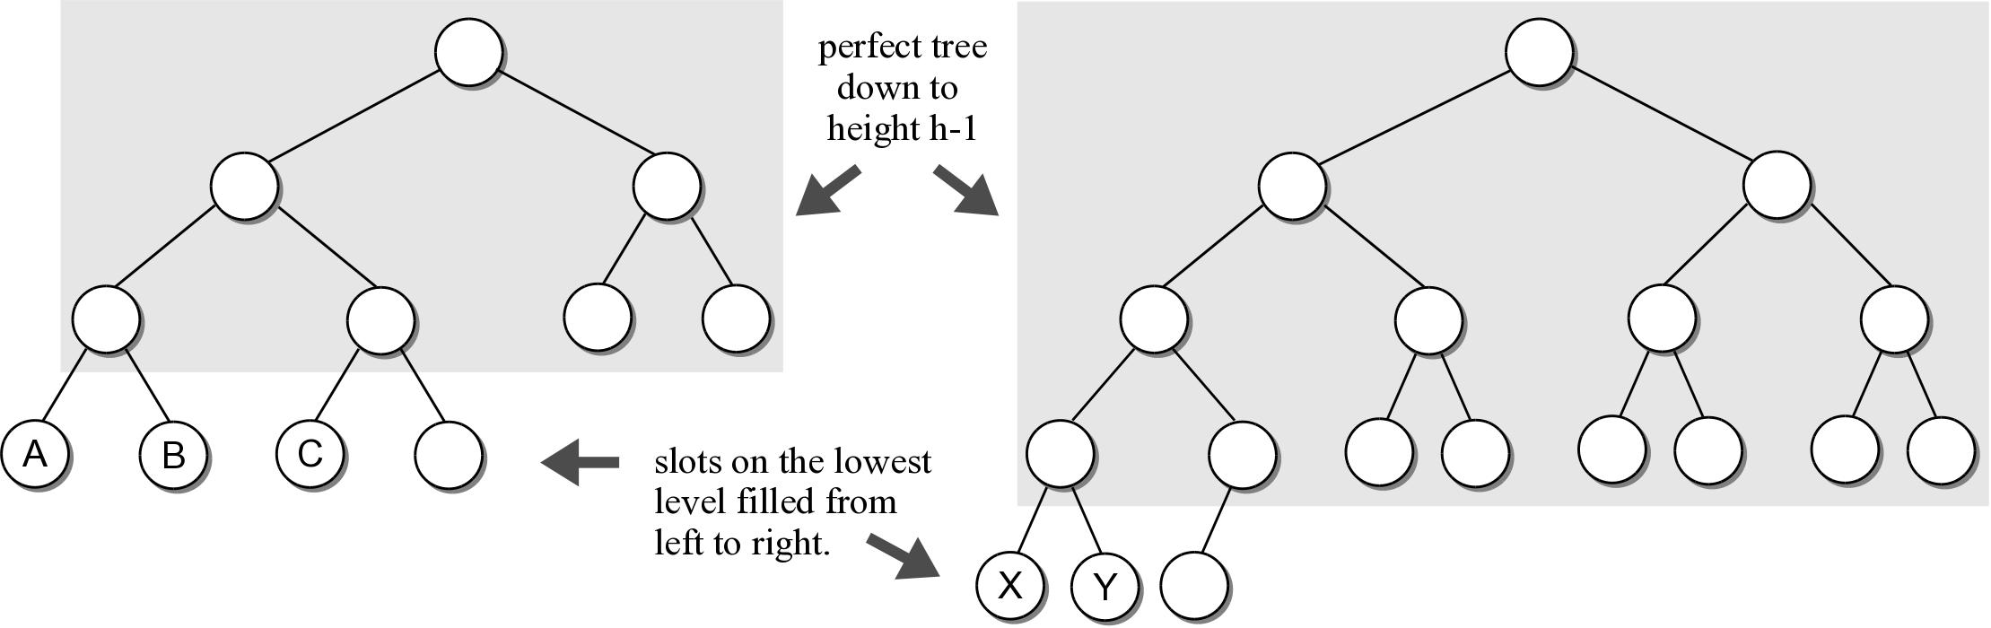
Complete Binary Tree
A binary tree of height h, is a perfect binary tree down to height h – 1 and the nodes at the lowest level are filled from left to right (no gaps).

Slide 3
Heaps
A heap is a complete binary tree in which the nodes are organized based on their data values.
heap order property – how the nodes in a heap or arranged.
heap shape property – as a complete binary tree.

Slide 4
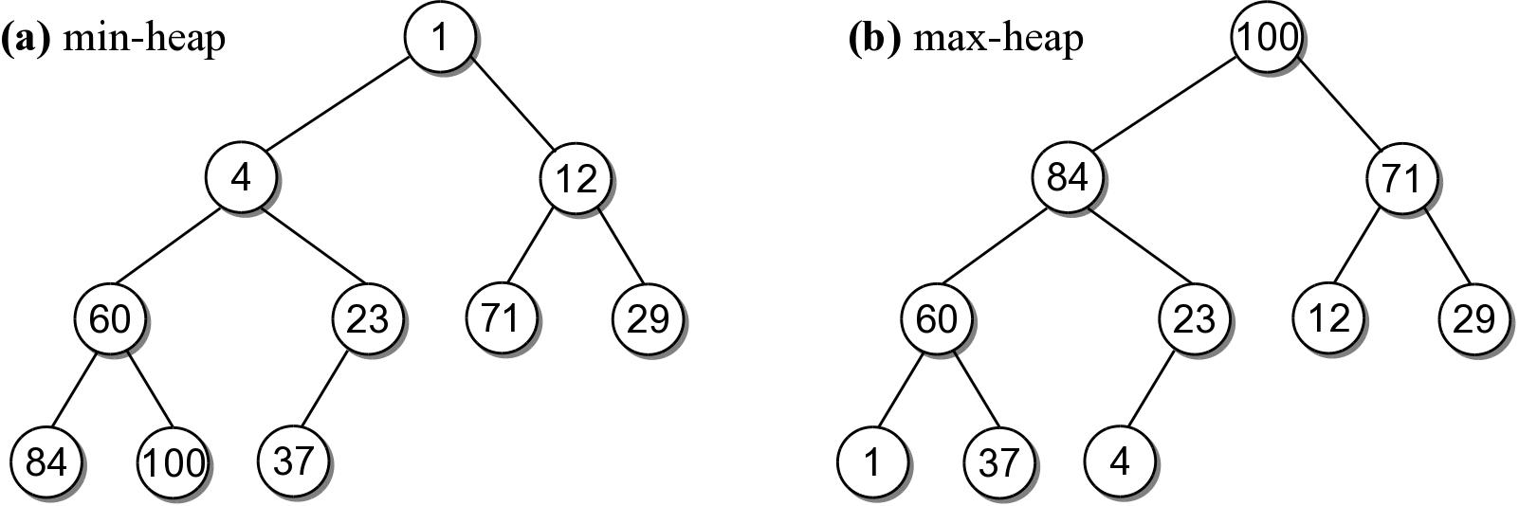
Example Heaps
For each non-leaf node V,
  max-heap: the value in V is greater than the value of its two children.
  min-heap: the value in V is smaller than the value of its two children.

Slide 5
Heap Operations
The heap is a specialized structure with limited operations.
  Insert an element into the heap.
  Remove the element from root node.

Slide 6
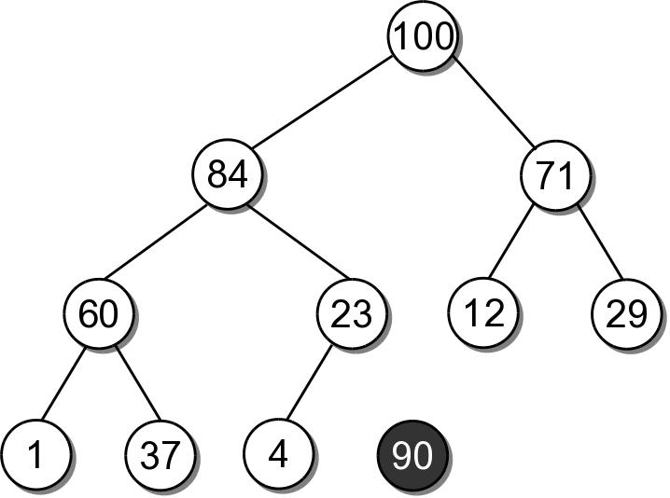
Heap Insertions
To properly insert an element into a heap involves several steps.
  Create a new node for value.

Slide 7
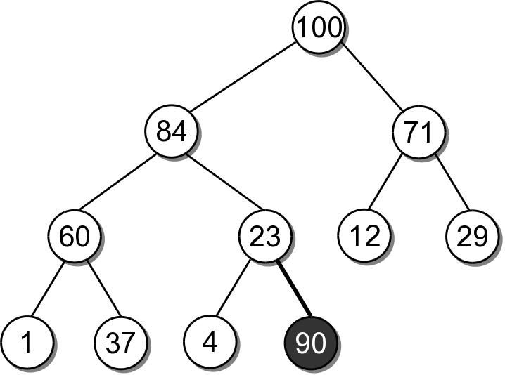
Heap Insertions
Link the node in as the last child in the complete tree.

Slide 8
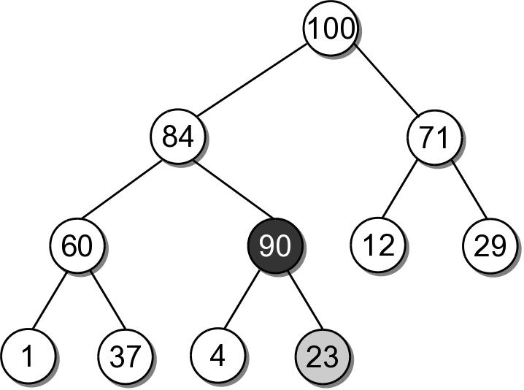
Heap Insertions
To restore the heap property, the new element has to move up along its path:
  the data is swapped with its parent's data.
  sift-up

Slide 9
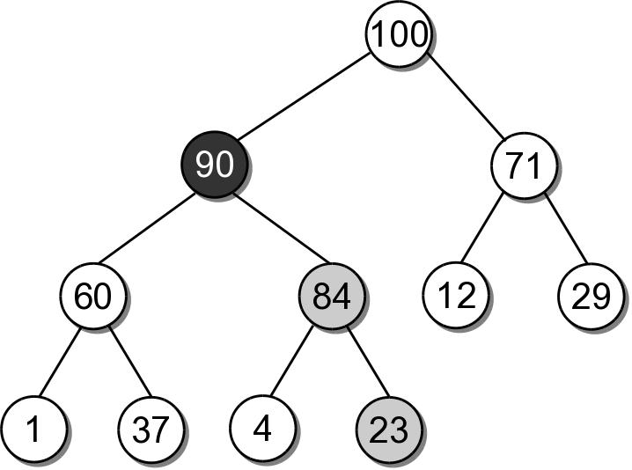
Heap Insertions
90 must move up another level since 84 is smaller.
After which, it is in it's correct position.

Slide 10
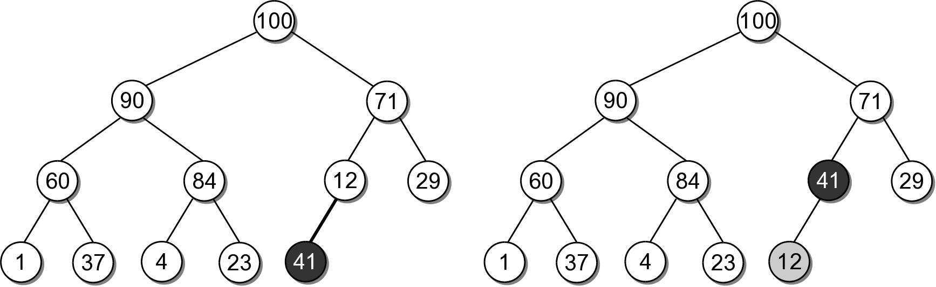
Heap Insert Example
Insert 41 into the heap from the previous slide.

Slide 11
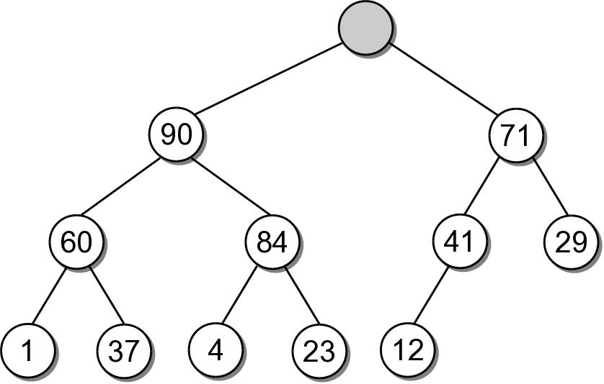
Heap Extractions
When an element is extracted from the heap, it can only come from the root node.
  Both heap properties must be maintained.

Slide 12
Heap Extractions
To restore the tree to a heap:
  another value will have to take the place of the extracted value in the root node.
  a node has to be removed from the tree.

Slide 13
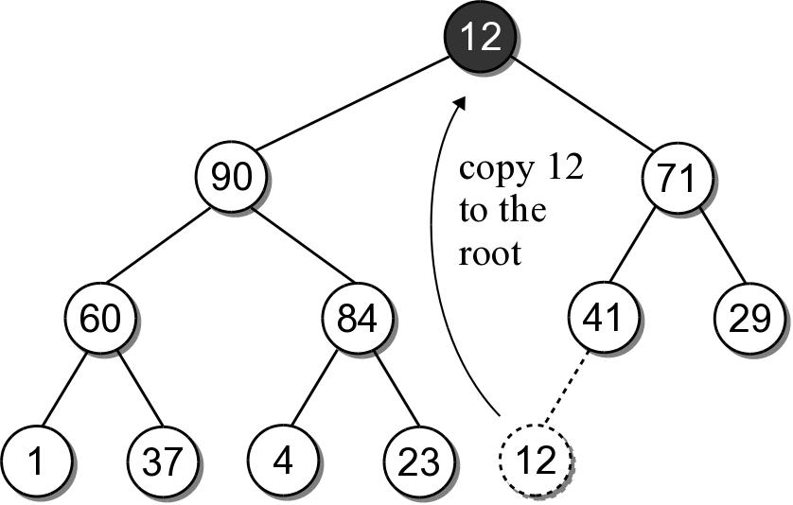
Heap Extractions
There is only one node that can be removed and still maintain the heap shape property.
  Copy the data from the last child node to the root.
  Delete the last child node.

Slide 14
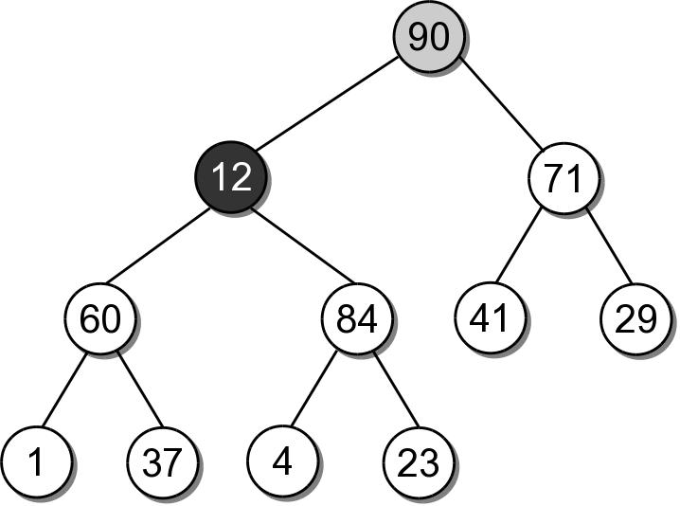
Heap Extractions
To maintain the heap order property, the new root value has to be sifted-down.

Slide 15
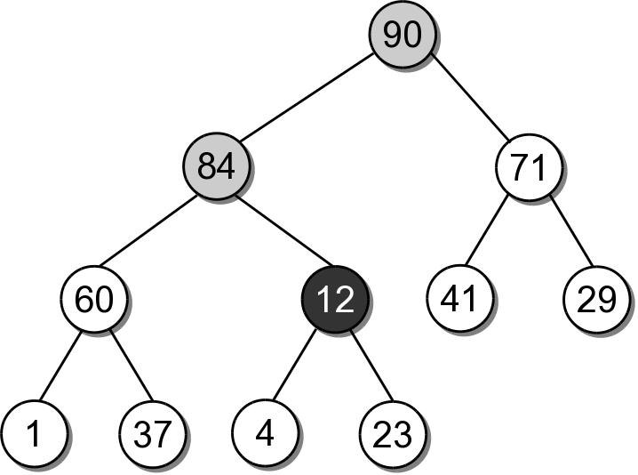
Heap Extractions
The shifting continues until the value is placed into a leaf node, or it is larger than its children.

Slide 16
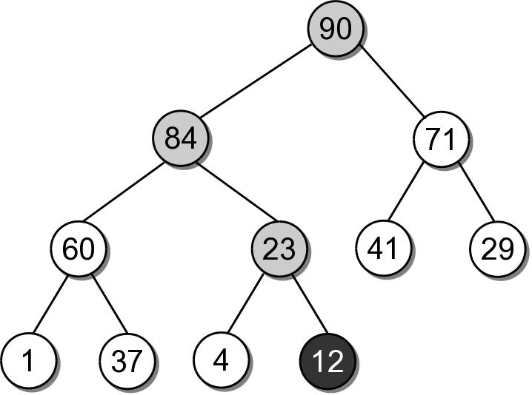
Heap Extractions
After being swapped with 23, value 12 will be in a node that maintains the heap order property.

Slide 17
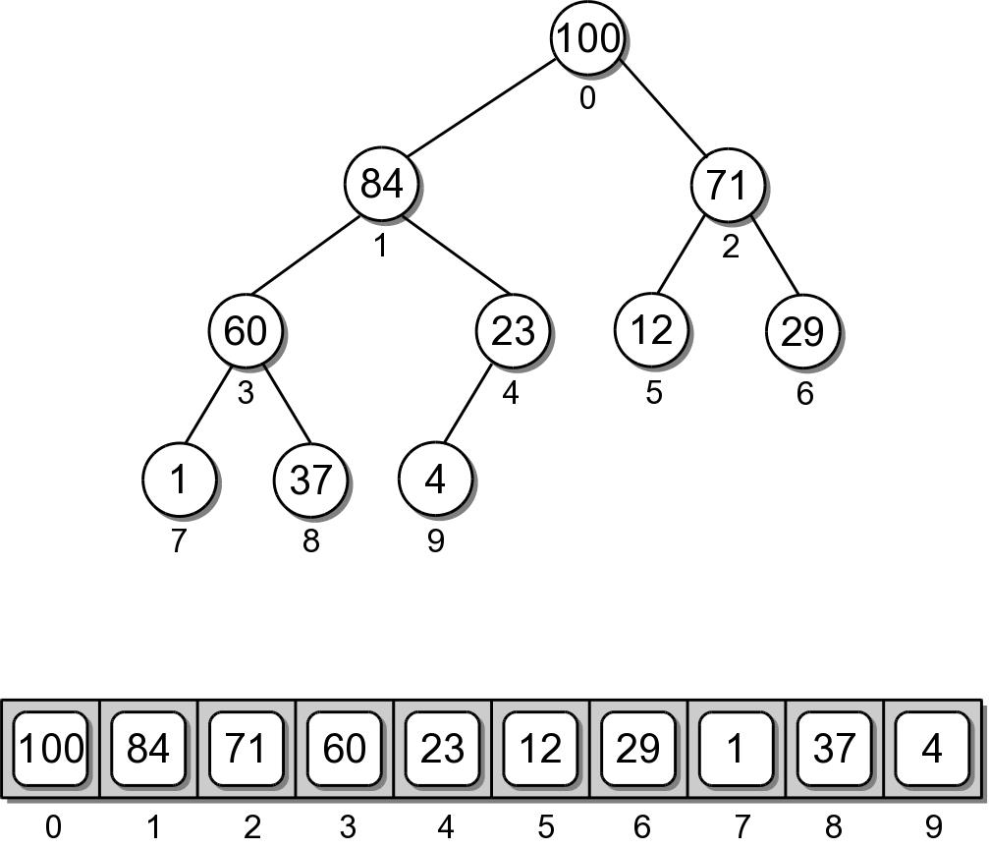
Heap Implementation
While a heap is a binary tree, it's seldom implemented as a dynamically linked structure.
  Use a sequence to physically store the nodes.

Slide 18
Heap – Node Access
The complete tree will never contain “holes”.
  The root will always be at position 0.
  Its two children will always occupy positions 1 and 2.
  The children of any node will always occupy the same position.

Slide 19
Heap – Node Access
Given the array index i
  parent = (i-1) // 2
  left = 2 * i + 1
  right = 2 * i + 2
A child link is null if the index is out of range.

Slide 20
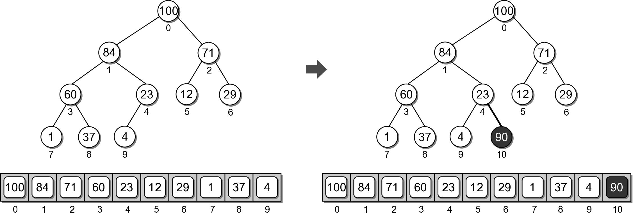
Heap Example
Physical view of adding value 90.

Slide 21
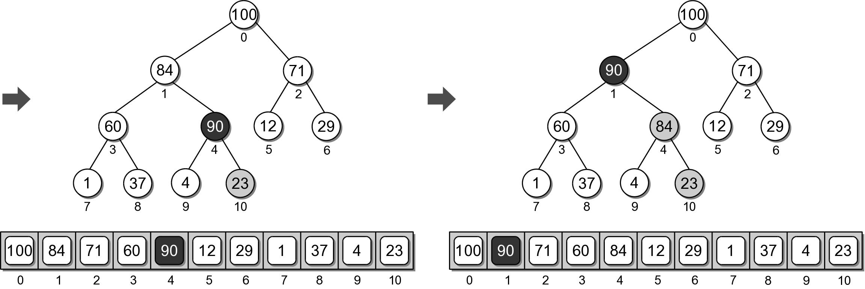
Heap Example
Physical view of adding value 90.

Slide 22
Heap Analysis
Assume a heap containing n elements:
  Insertion: O(log n)
  Extraction: O(log n)

Slide 23
The Heapsort
The simplicity and efficiency of the heap structure can be applied to the sorting problem.
  Build a heap from a sequence of unsorted keys.
  Extract the keys from the heap to create a sorted sequence.
Very efficient: O(n log n)

Slide 24
Heapsort Implementation
A simple implementation is provided below.
def simpleHeapSort( theSeq ):
# Create an array-based max-heap.
n = len(theSeq)
heap = MaxHeap( n )
# Build a max-heap from the list of values.
for item in theSeq :
heap.add( item )
# Extract each value from the heap and store
# them back into the list.
for i in range( n, 0, -1 ) :
theSeq[i] = heap.extract()

Slide 25
In-Place Heapsort
The previous version required additional storage for the heap.
The entire process can be done in-place within the original sequence.
  Suppose we are given the following array

Slide 26
In-Place Heapsort
The first step is to construct a max-heap.
  The heap nodes occupy the array from front to back.
  We can keep the heap elements in the front and those yet to be added at the back.
  Keep track of where the heap ends.

Slide 27
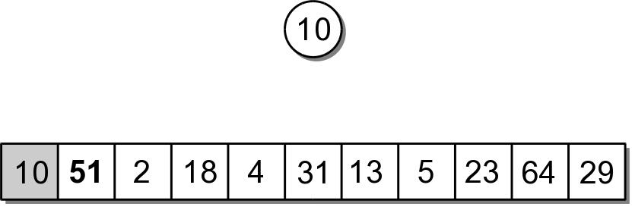
In-Place Heapsort
The first value in the array represents a max-heap of one element.

Slide 28
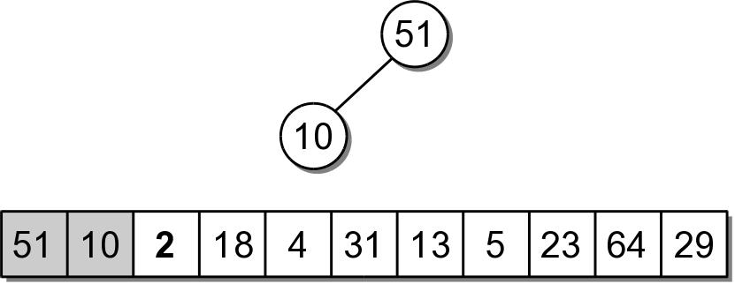
In-Place Heapsort
The next value to be added, is the next in the array.
  The value is copied to the root node (position 0).
  Then sifted down.

Slide 29
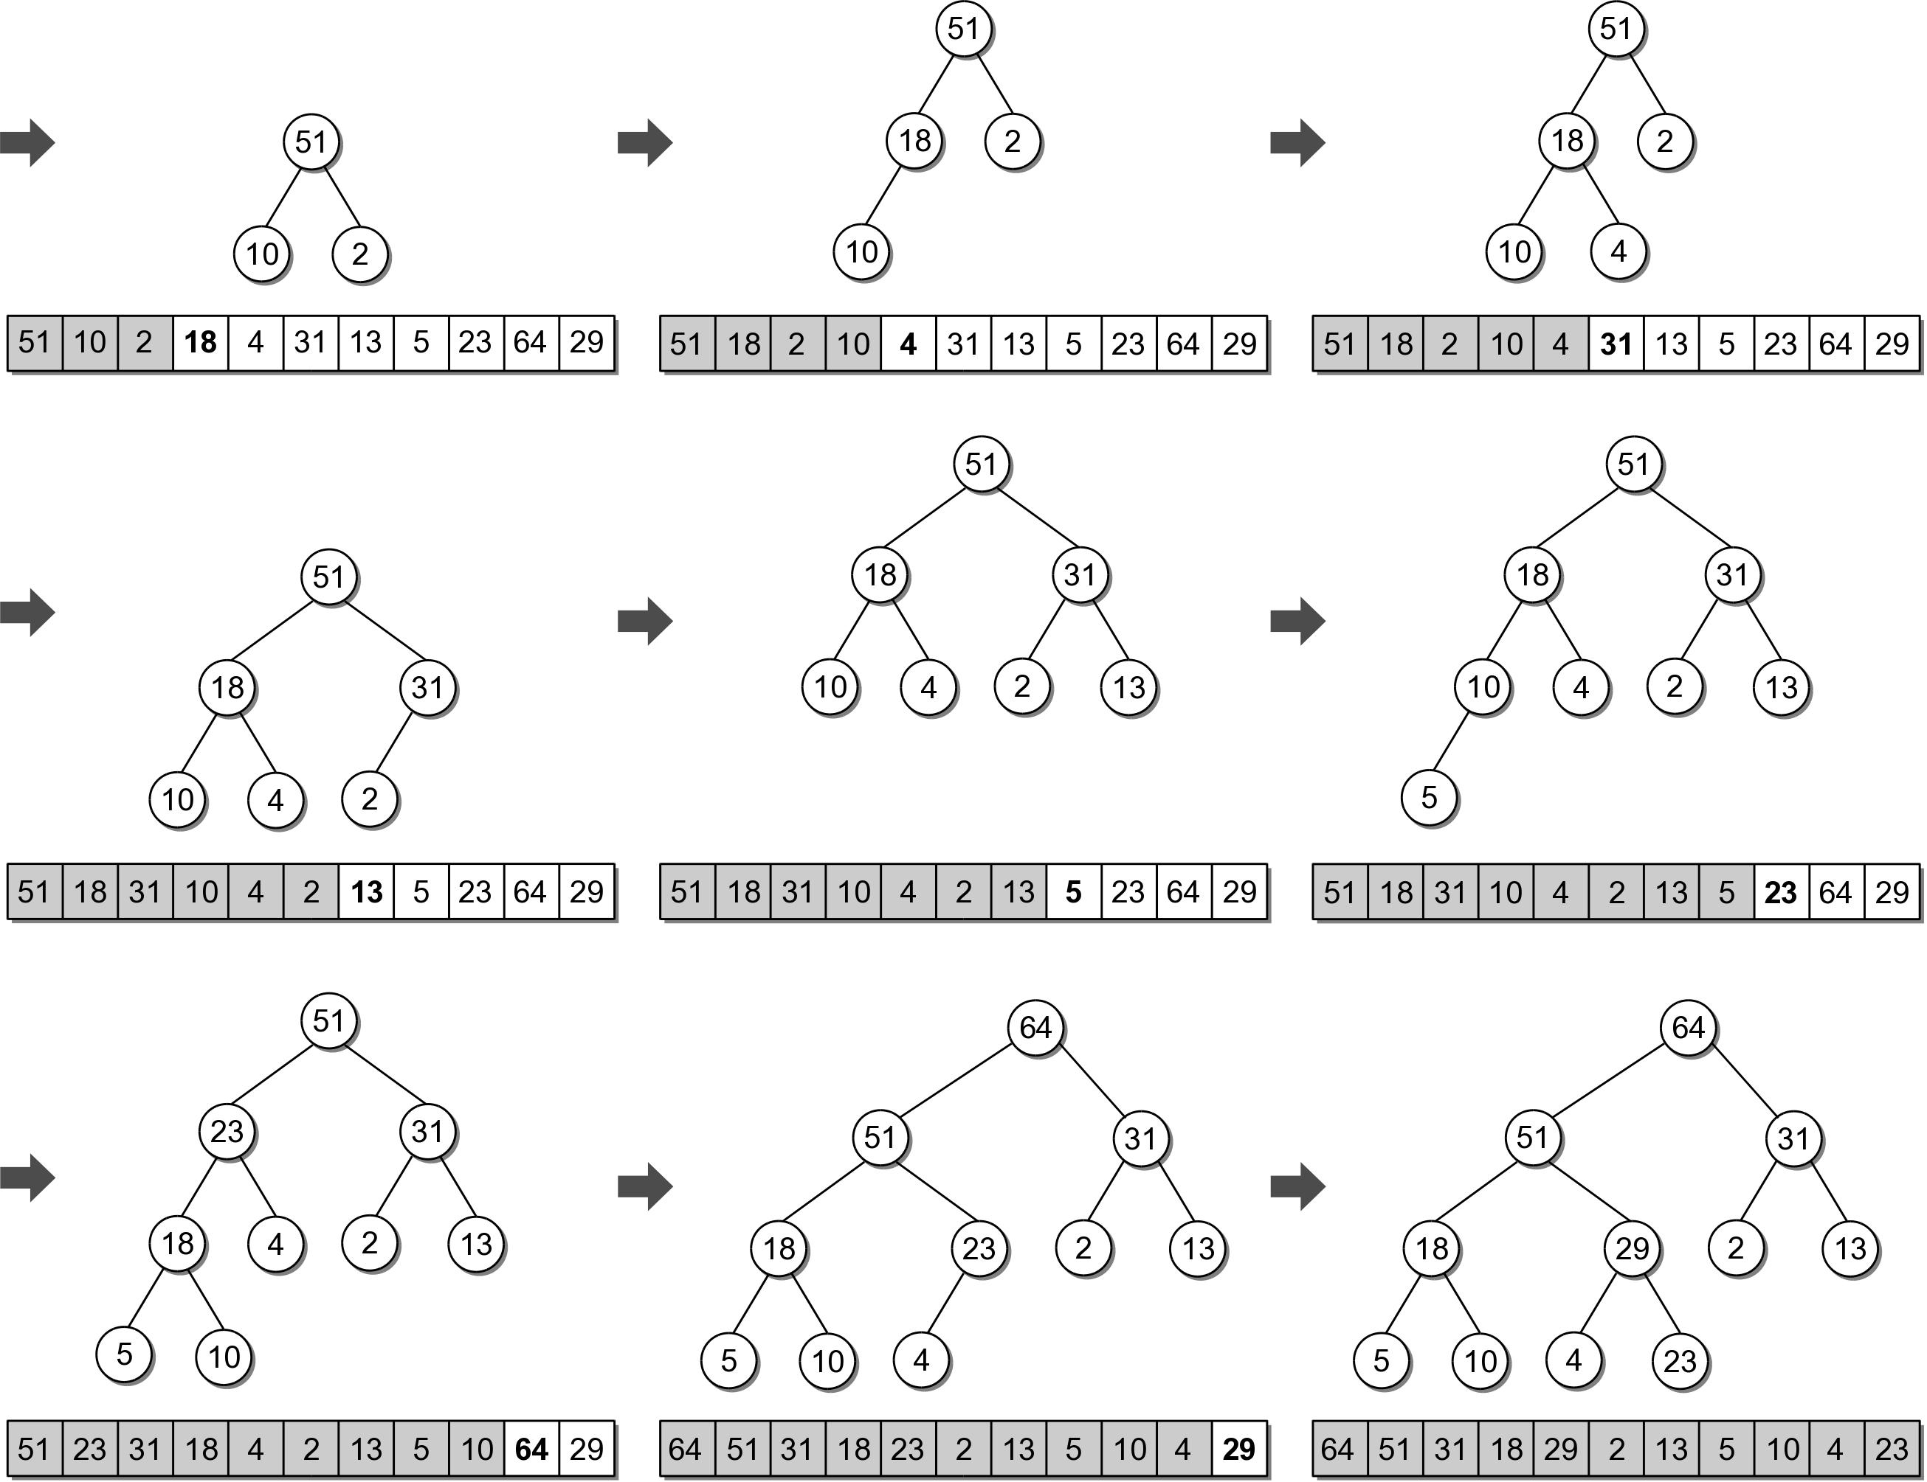
In-Place Heapsort

Slide 30
In-Place Heapsort
The next step is to extract the values from the heap and build the sorted sequence.
  When the root is extracted, the last child node is copied to the root.
  The last child node is stored in the last element of the heap.
  We can simply swap the two values.

Slide 31
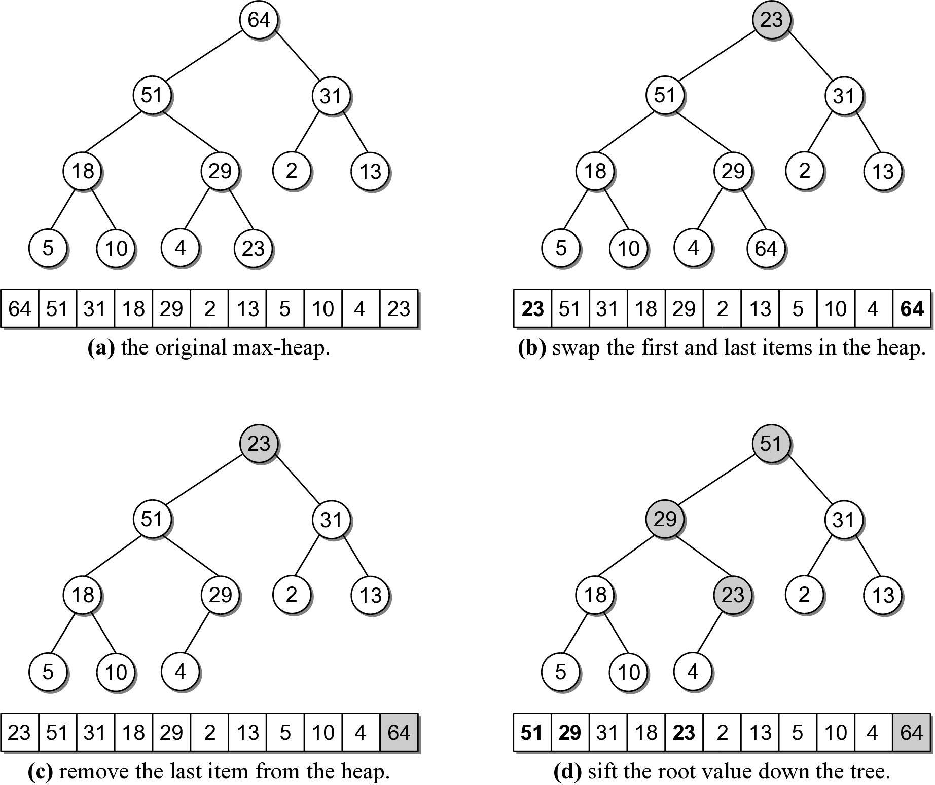
In-Place Heapsort

Slide 32
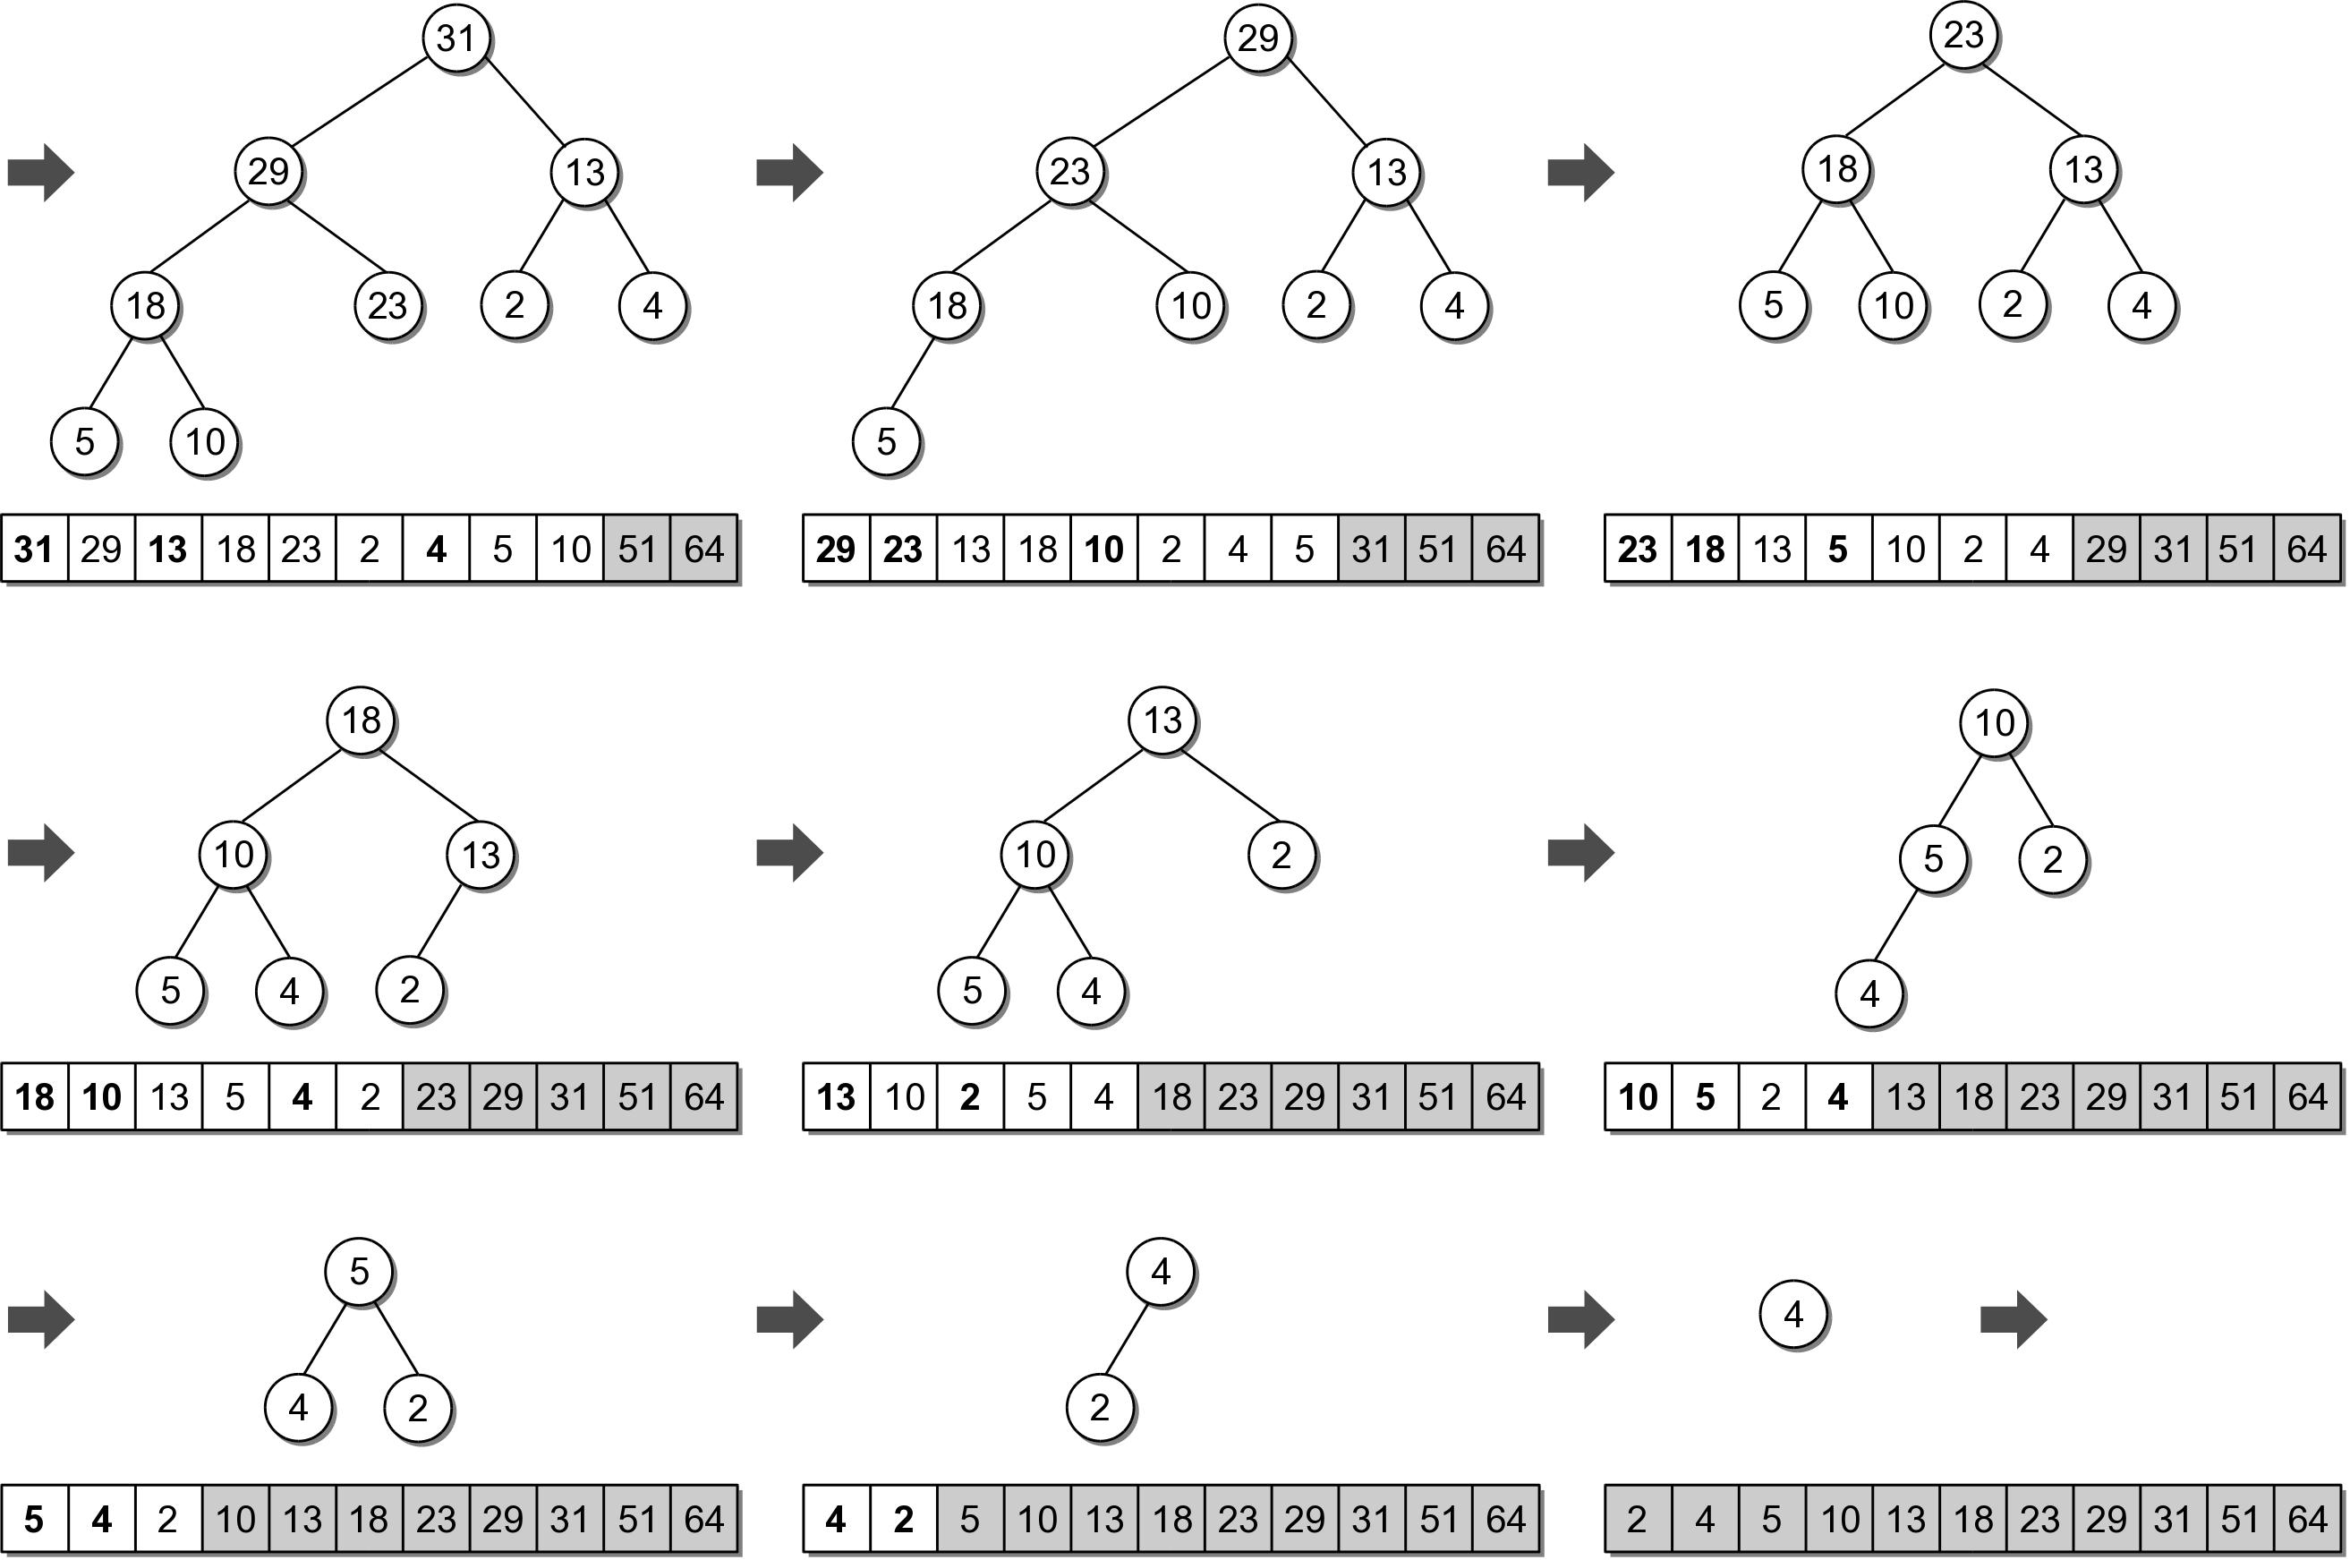
In-Place Heapsort

Slide 33
Decision Tree
Models a sequence of decisions or choices in which selections are made in stages from among multiple alternatives at each stage.
  Nodes represent the stages.
  Branches indicate the decisions that can be made.
Classic example:
  Automated phone menu.

Slide 34
Morse Code
The modern International Morse Code uses dots (dits), dashes (dahs), short gaps and long gaps.
A | .- | F | ..-. | K | -.- | P | .--. | U | ..-
B | -... | G | --. | L | .-.. | Q | --.- | V | ...-
C | -.-. | H | .... | M | -- | R | .-. | W | .--
D | -.. | I | .. | N | -. | S | ... | X | -..-
E | . | J | .--- | O | --- | T | - | Y | -.--
 |  |  |  |  |  |  |  | Z | --..

Slide 35
Application: Morse Code
A type of character encoding originally designed in the late 1830s by Samuel Morse.
  For use with his telegraph system.
  Allows messages to be transmitted long distances across wires.
  Used extensively by American railroad companies.

Slide 36
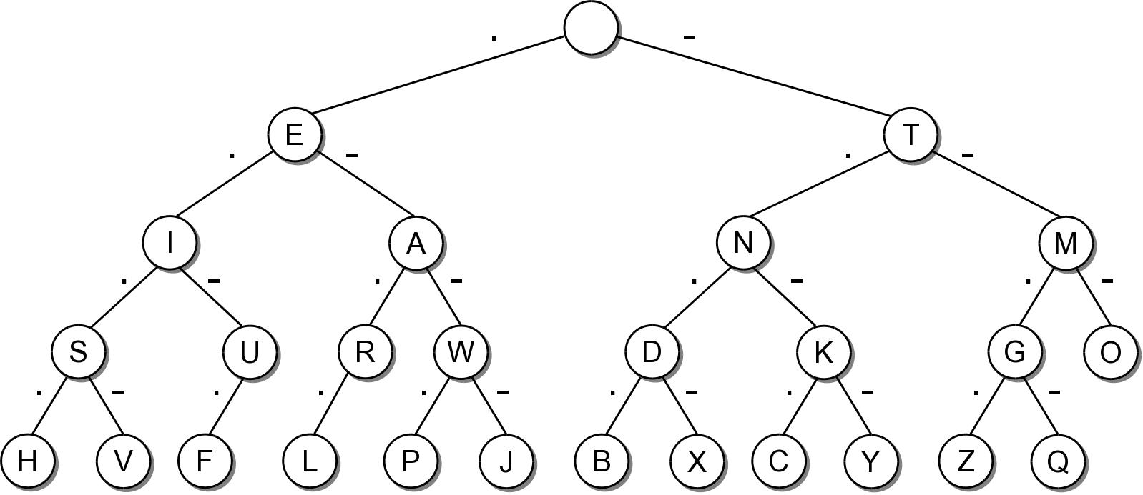
Morse Code Decision Tree
We can use a decision tree to represent the Morse Code translations.

Slide 37
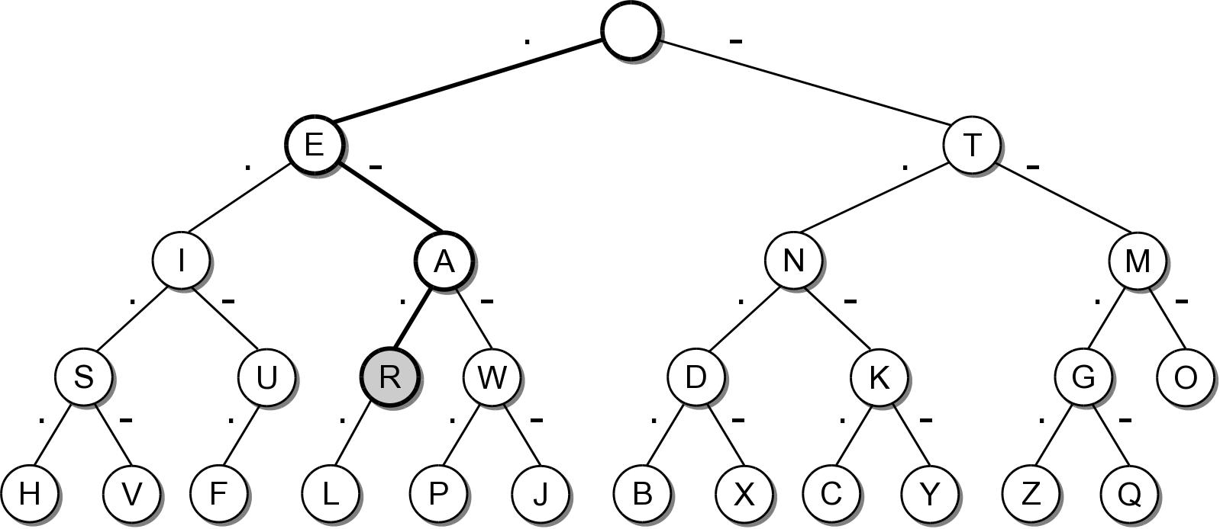
Morse Code Example
Decoding a valid sequence.

Slide 38
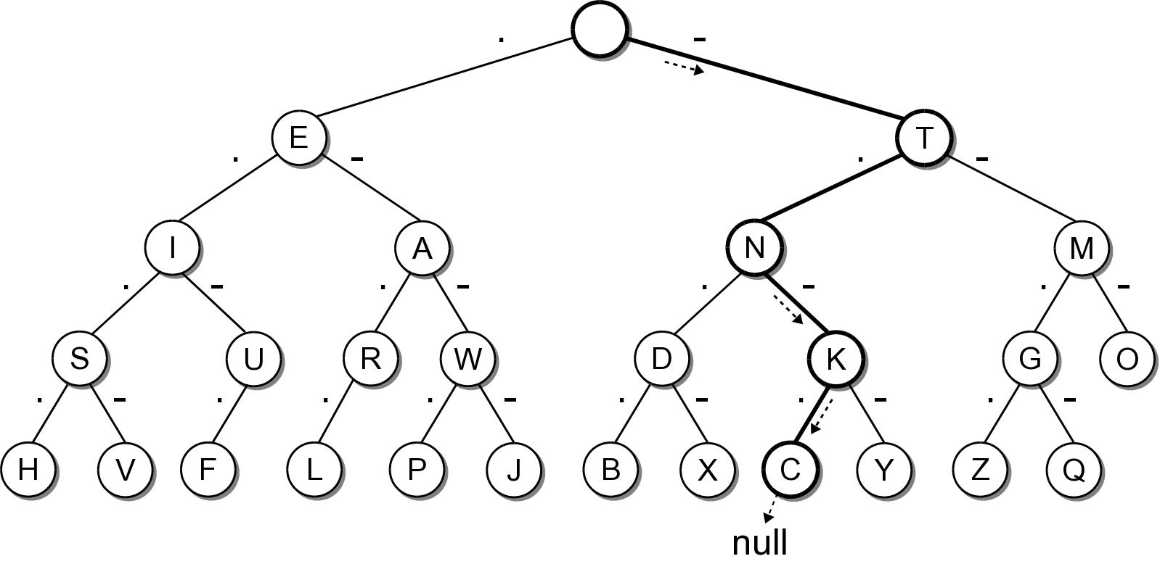
Morse Code Example
Decoding an invalid sequence.

